Slide 1
PreK News
Week of: April 20-24, 2020
A Note from
Your Teachers
We want to see you! Send us
pics of you doing your work with a smile on your face☺
 | I station Reading- complete 40 minutes this week I station Math- complete 40 minutes this week
Math | Count to 100 by 1s, 5s and 10s everyday Write numbers 1-30 Make AAB patterns using shapes i.e. triangle, triangle, square, triangle, triangle, square Identify all 2D and 3D shapes
Assignments for the Week
Computer
Book: A Tree For All Seasons read by Shellie Watkins-YouTube
Book: What Makes the Seasons? read by Fun2Learn-YouTube Discuss the 4 seasons and what happens in each.
Sing along: Seasons Song by HaveFunTeaching-YouTube and The Four seasons by ABCMouse-YouTube
Reading
Writing
Write first and last name. 4x each.
Write the alphabet, point to letters and say its sound.
Science
4Seasons: Divide paper into 4 quadrants. Label each with the a season. Draw a picture for each season.
Dictate a sentence about your favorite season.
Social
Studies
Practice saying “My mom/dad’s phone number is ______________.
Practice this several times daily until memorized.
Take a pic of your child with the completed activity and send it to your teacher on ClassDojo!

Slide 2
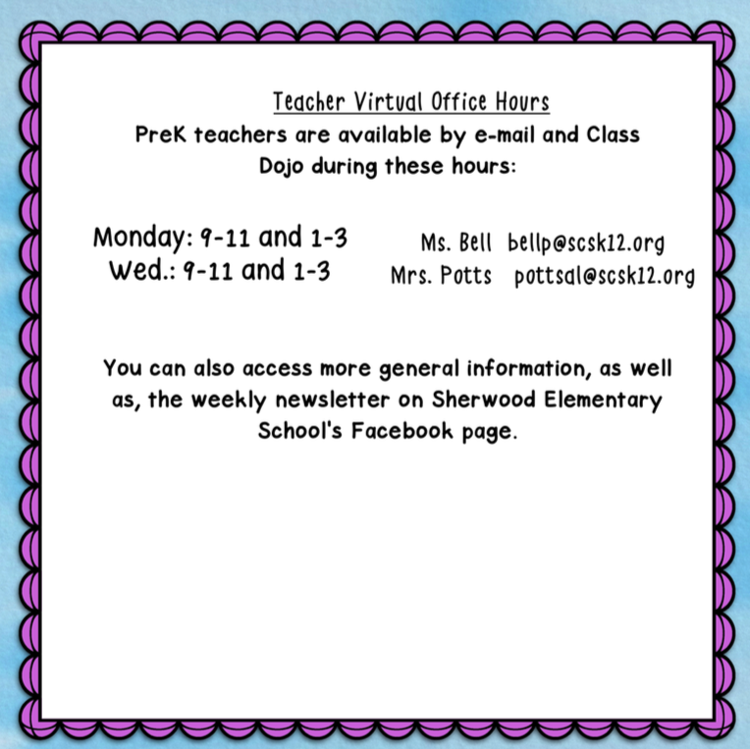
Page 2

